Slide 1
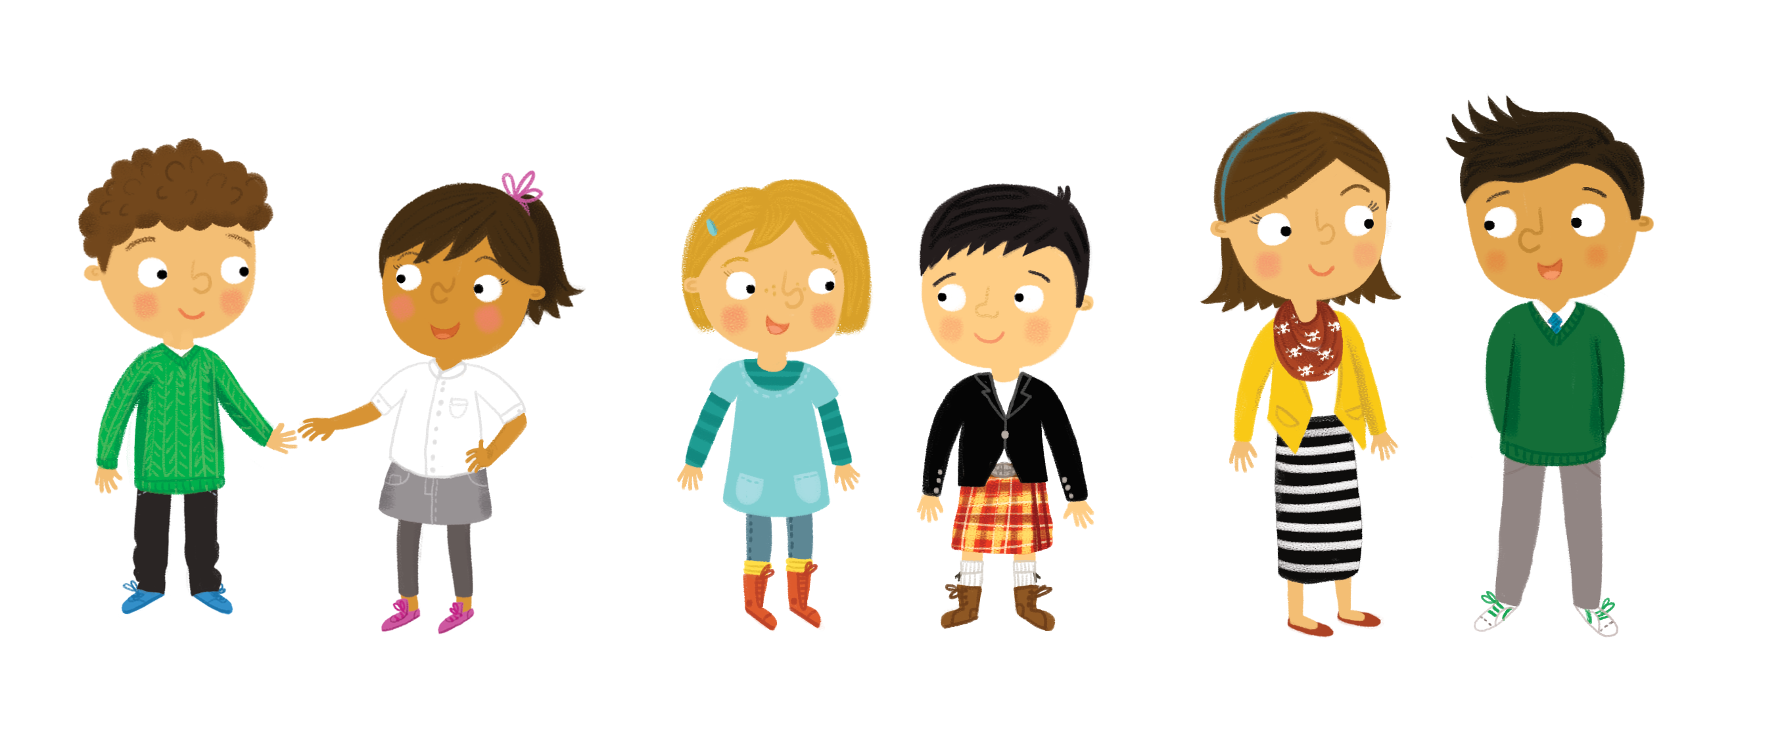

Tha geansaidh ort.
Notes:
You are wearing a jumper.

Slide 2
Tha briogais ort.
Notes:
You are wearing trousers.

Slide 3
Tha brògan ort.
Notes:
You are wearing shoes.

Slide 4
Tha lèine ort.
Notes:
You are wearing a shirt.

Slide 5
Tha sgiort ort.
Notes:
You are wearing a skirt.

Slide 6
Tha brògan ort.
Notes:
You are wearing shoes.

